Slide 1
SPORTHUB
Just sports, no hard feelings
GROUP NO - 5
Adarsh Sharma
Sudhanshu Bhardwaj
Naman Upadhyay
Adarsha Kanthabailu
Adithya Bhat

Slide 2

About our project
Introducing the all new e-commerce sports store “SPORTHUB”. Made with ❤️ from THBS UI Team . The application is all about your online sports store where you can able to explore various sports equipments, Clothing ,Proteins and supplements and Once you make a mood you can also able to order it. Sounds Great Right!!!!!

Slide 3
Technologies Used
HTML
CSS
Bootstrap5
JavaScript
Angular/ReactJS

Slide 4
Our FrontEnd Contents
Login Page (User/Admin)
SignUp Page
User Account Profile
Home Page
Products Page
Cart Page
Wishlist Page
Orders Page
About Us
Contact Us
Feedback Form

Slide 5
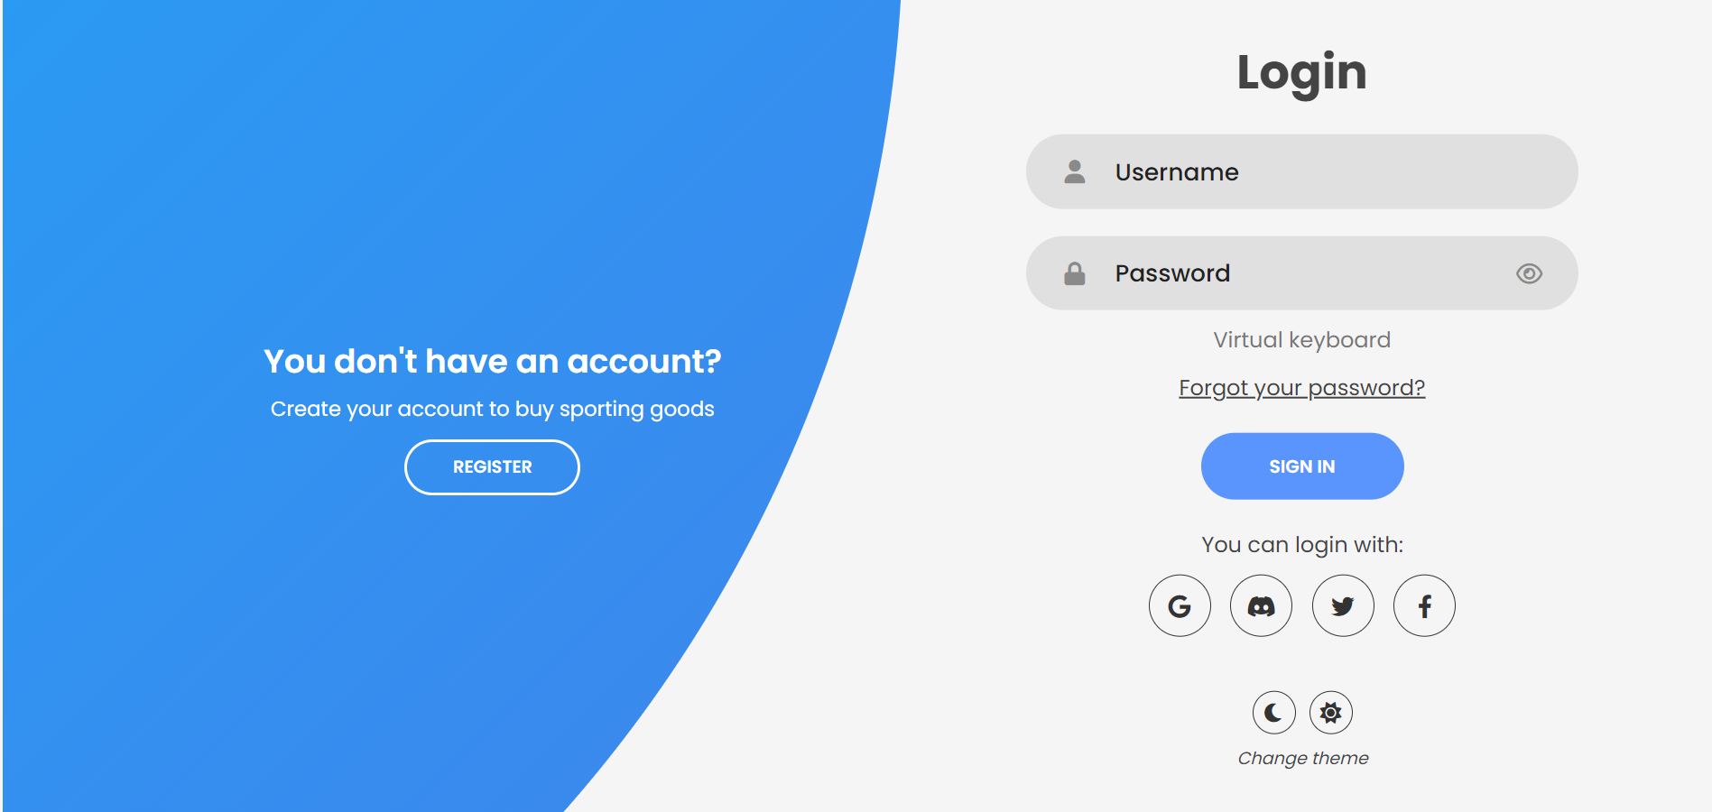
LogIn Page
From this page user can able to login to our e-commerce store. User can also login through Google, Facebook, Twitter. If you not registered then you can register also.

Slide 6
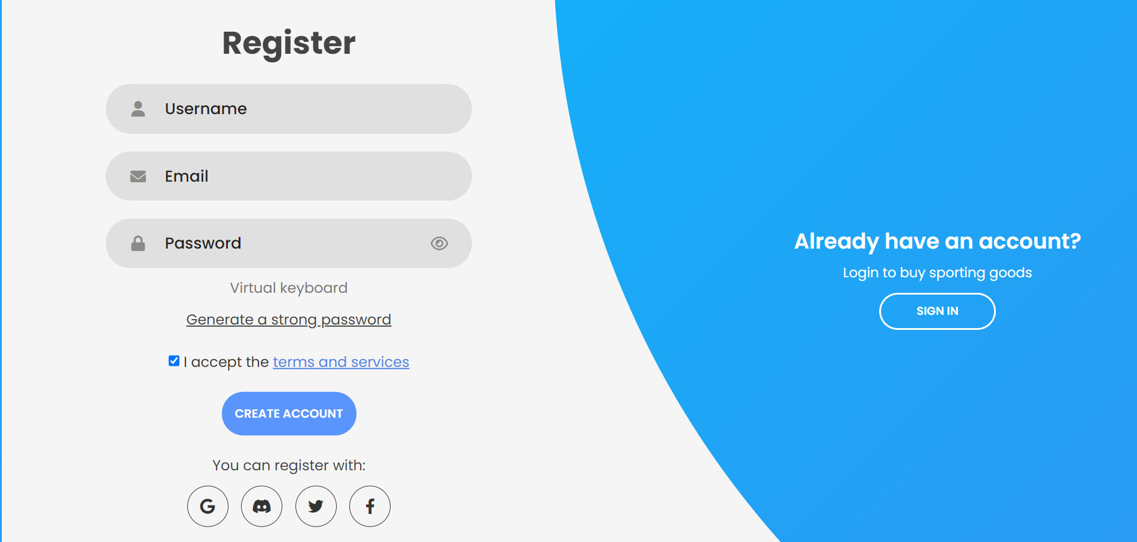
SignUP Page
From this page user can able to SignUp to our e-commerce store. User can also signup through Google, Facebook, Twitter. If you are already registered then you can login also.

Slide 7
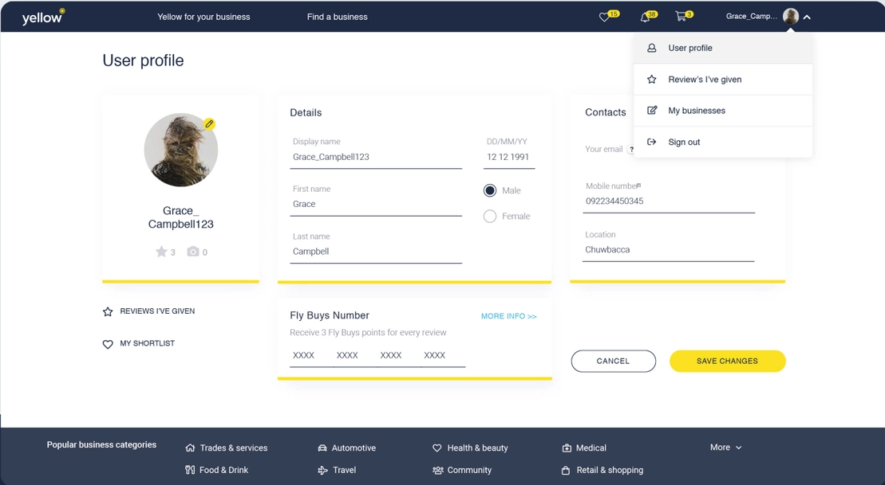
User Account profile
This page shows user account details(Profile).
Like name, dateofbirth, user picture, address, contact information , email, mobile etc.

Slide 8
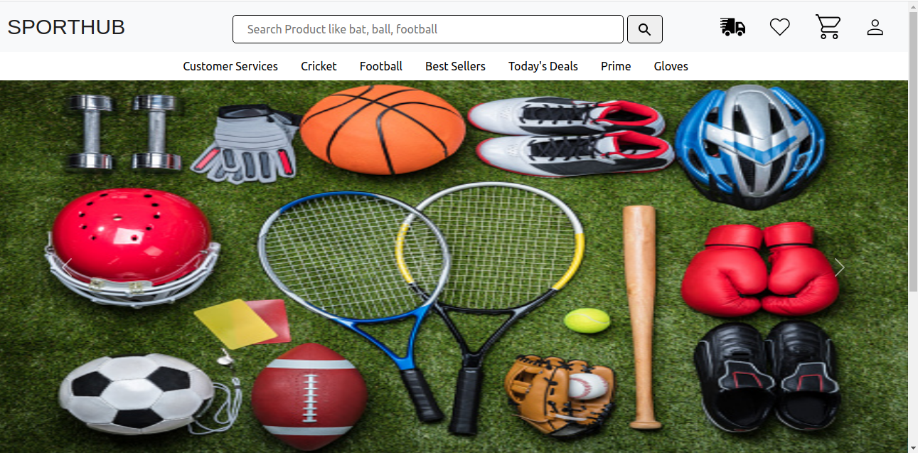
HomePage
This page shows the homepage of our store where it contains all navigations , products categories, Bank offers and other discounts , recommendation of products

Slide 9
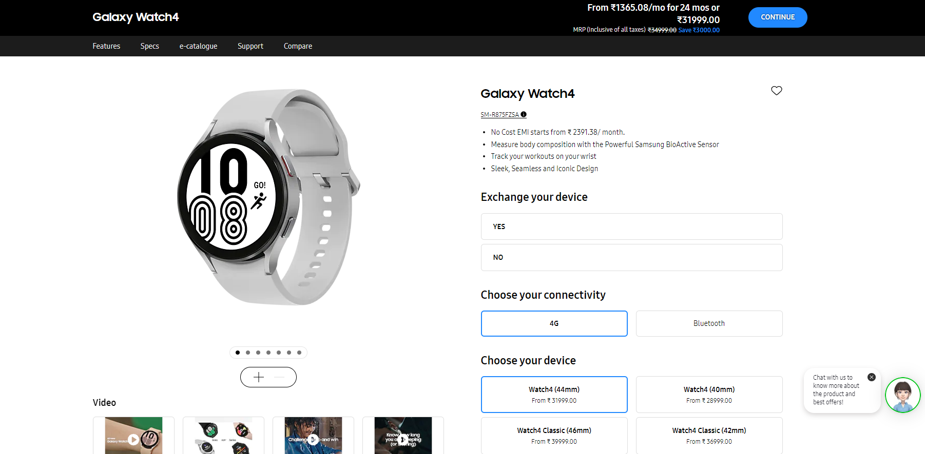
Product Page
This page shows the product details like all images , their specifications , price , uses, manual, type and add to cart or buy now option also.

Slide 10
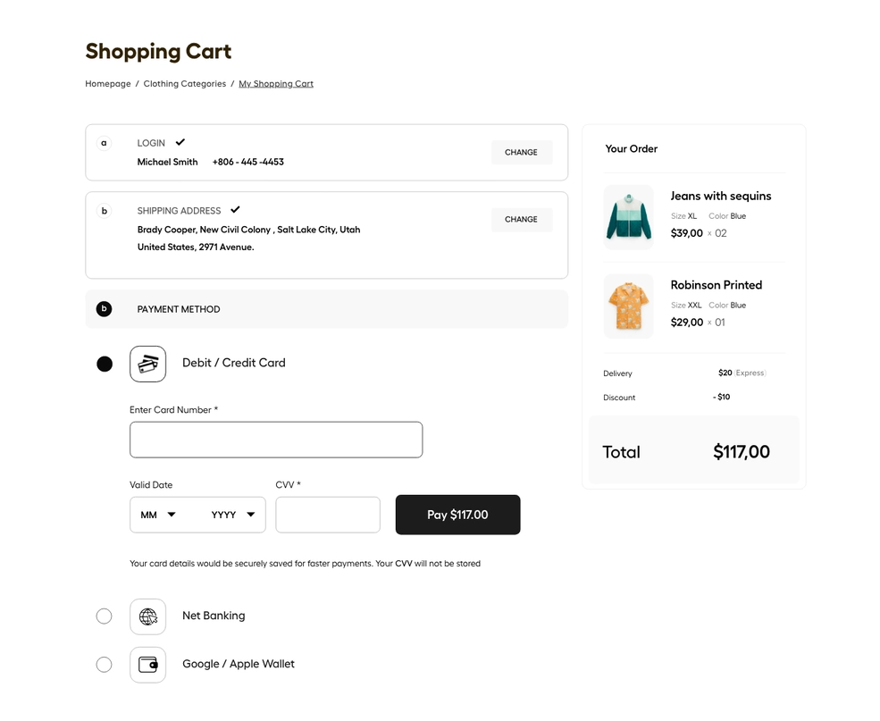
Cart Page
This page shows all the items you have added to cart ,total amount and contains payment button.

Slide 11
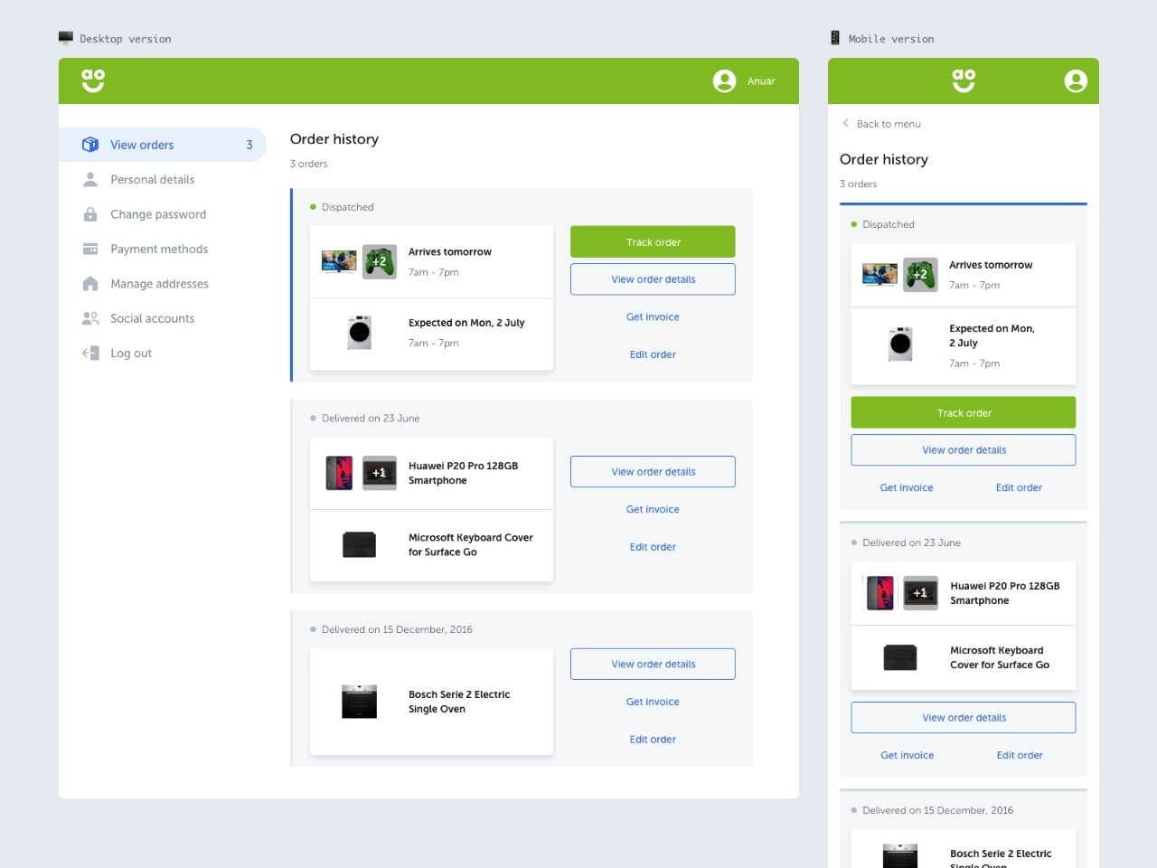
Orders Page
This page shows all the order you have placed and tracking details.

Slide 12

ABOUT US Page
This page shows details about our company and team.

Slide 13
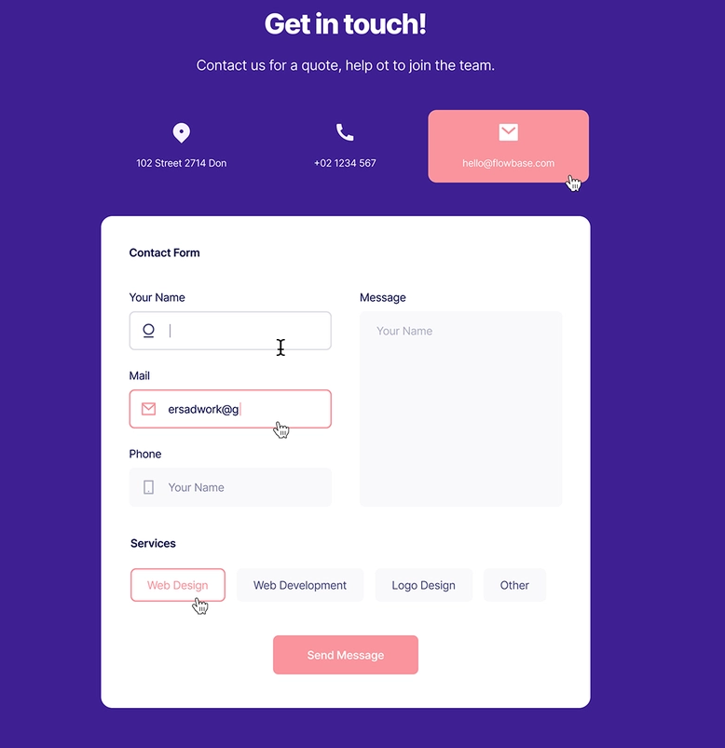
Contact US Page
From this page you can able to contact us through a contact form. Our team will get back to you within 24 hrs. You can also dial on contact no. or mail us.

Slide 14
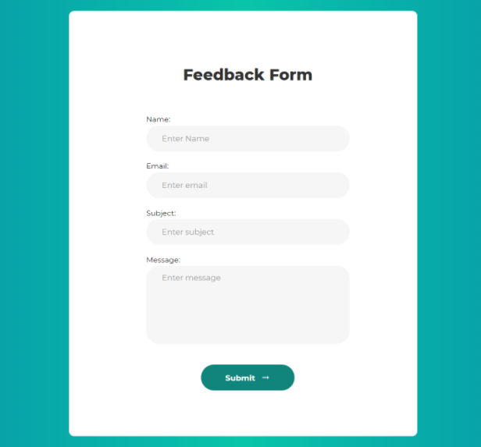
FeedBack Page
This page shows a feedback form where user can give a feedback to our team and company which help us to give you better services ahead in future.

Slide 15
Future Scope
Payment Page (UPI/CC/EMI/Wallets)
Recommendations of products
Order Tracking
Notifications via Email

Slide 16
Conclusion
Frontend is the most important part in the UI which enables users to attract and gives a better user experience. Tried to give a good UX experience and better features in our E-commerce. As with respect to time new changes and new features will be added to our online store.

Slide 17
THANK YOU😊

